Slide 1
Worldwide databases 2025-01-22
🌎🌍🌏 📀
Notes:
Office hours
Participation quiz – how was it?

Slide 2
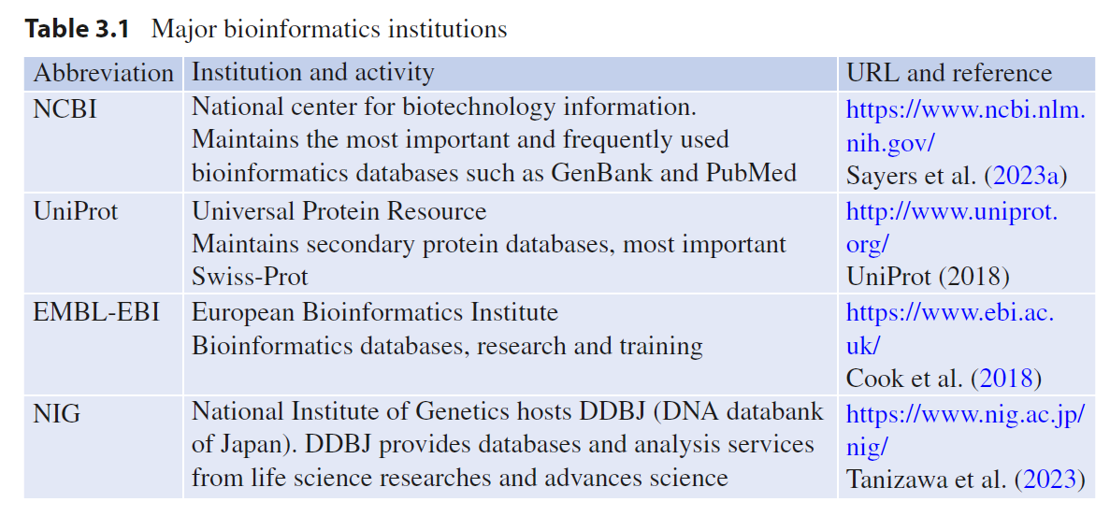
Major bioinformatics institutions

Slide 3




Outline
(very brief) History of
NCBI
ENA
DDBJ
INSDC (NCBI+ENA+DDBJ)
How to use NCBI
Other databases

Slide 4
GenBank to NCBI
GenBank, Los Alamos, 1970s
Transferred to NCBI/NIH, 1992
NCBI: National Center of Biotechnology Information
NIH: National Institutes of Health
🌎
Sources:
http://www.bio.net/bionet/mm/bionews/1994-January/000877.html

Slide 5
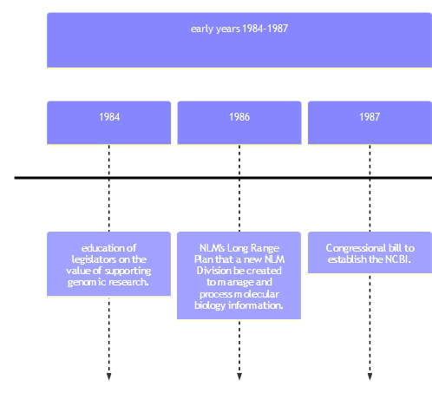
GenBank to NCBI
🌎
Notes:
For https://mermaid.live:
timeline
title Evolution of NCBI Tools and Resources
section early years 1984-1987
1984 : education of legislators on the value of supporting genomic research.
1986 : NLM's Long Range Plan that a new NLM Division be created to manage and process molecular biology information.
1987 : Congressional bill to establish the NCBI.
section after NCBI was created
1990 : BLAST is introduced, optimizing sequence comparison for speed.
1991 : Entrez search and retrieval system is introduced in CD form.
1992 : NCBI assumes responsibility for GenBank.
1993 : Network Entrez brings Entrez to the Internet.
1994 : NCBI establishes its website, initially hosting BLAST and Entrez.
1997 : PubMed is launched, providing access to the MEDLINE database.
1999 : Human Genome Project deposits the first human chromosome data; Genomic resources like RefSeq are released.
2002 : GenBank includes Whole Genome Shotgun sequences.

Slide 6
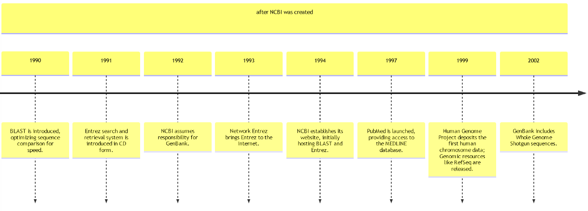
GenBank to NCBI
Notes:
For https://mermaid.live:
timeline
title Evolution of NCBI Tools and Resources
section early years 1984-1987
1984 : education of legislators on the value of supporting genomic research.
1986 : NLM's Long Range Plan that a new NLM Division be created to manage and process molecular biology information.
1987 : Congressional bill to establish the NCBI.
section after NCBI was created
1990 : BLAST is introduced, optimizing sequence comparison for speed.
1991 : Entrez search and retrieval system is introduced in CD form.
1992 : NCBI assumes responsibility for GenBank.
1993 : Network Entrez brings Entrez to the Internet.
1994 : NCBI establishes its website, initially hosting BLAST and Entrez.
1997 : PubMed is launched, providing access to the MEDLINE database.
1999 : Human Genome Project deposits the first human chromosome data; Genomic resources like RefSeq are released.
2002 : GenBank includes Whole Genome Shotgun sequences.

Slide 7
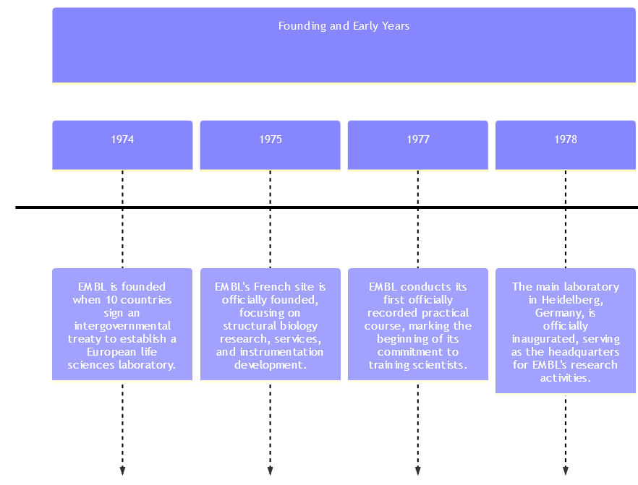
European Nucleotide Archive (ENA) 🌍
Sources
https://www.embl.org/about/history/
Notes:
timeline
title Evolution of EMBL
section Founding and Early Years
1974 : EMBL is founded when 10 countries sign an intergovernmental treaty to establish a European life sciences laboratory.
1975 : EMBL's French site is officially founded, focusing on structural biology research, services, and instrumentation development.
1977 : EMBL conducts its first officially recorded practical course, marking the beginning of its commitment to training scientists.
1978 : The main laboratory in Heidelberg, Germany, is officially inaugurated, serving as the headquarters for EMBL's research activities.
section Database and Technology Advancements
1980 : The EMBL Data Library is established, laying the foundation for the European Nucleotide Archive.
1982 : The first release of the EMBL Nucleotide Sequence Database is made, containing around 500,000 base pairs.
1987 : The EMBL File Server is introduced, serving database records over early networks like BITNET, EARN, and the Internet.
section Relocation and Expansions
1993 : EMBL's Nucleotide Sequence Database is relocated to the European Bioinformatics Institute (EBI) from Heidelberg.
section Modern Developments
2004 : Limits on the maximum sequence length for database records are removed, allowing entire genome sequences to be stored as single entries.
2019 : Edith Heard becomes the fifth Director General of EMBL and the first woman to hold this position.
2022 : EMBL announces its five-year scientific programme, "Molecules to Ecosystems," under the leadership of Edith Heard.

Slide 8
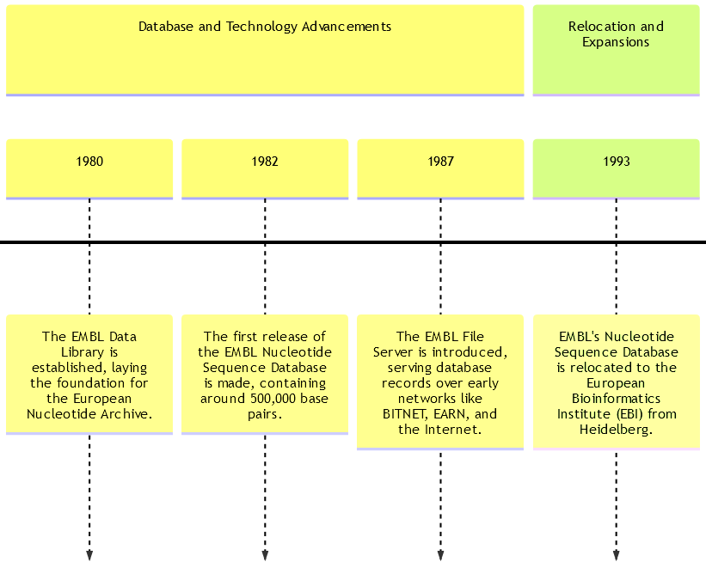
European Nucleotide Archive (ENA) 🌍
Sources
https://www.embl.org/about/history/
Notes:
timeline
title Evolution of EMBL
section Founding and Early Years
1974 : EMBL is founded when 10 countries sign an intergovernmental treaty to establish a European life sciences laboratory.
1975 : EMBL's French site is officially founded, focusing on structural biology research, services, and instrumentation development.
1977 : EMBL conducts its first officially recorded practical course, marking the beginning of its commitment to training scientists.
1978 : The main laboratory in Heidelberg, Germany, is officially inaugurated, serving as the headquarters for EMBL's research activities.
section Database and Technology Advancements
1980 : The EMBL Data Library is established, laying the foundation for the European Nucleotide Archive.
1982 : The first release of the EMBL Nucleotide Sequence Database is made, containing around 500,000 base pairs.
1987 : The EMBL File Server is introduced, serving database records over early networks like BITNET, EARN, and the Internet.
section Relocation and Expansions
1993 : EMBL's Nucleotide Sequence Database is relocated to the European Bioinformatics Institute (EBI) from Heidelberg.
section Modern Developments
2004 : Limits on the maximum sequence length for database records are removed, allowing entire genome sequences to be stored as single entries.
2019 : Edith Heard becomes the fifth Director General of EMBL and the first woman to hold this position.
2022 : EMBL announces its five-year scientific programme, "Molecules to Ecosystems," under the leadership of Edith Heard.

Slide 9
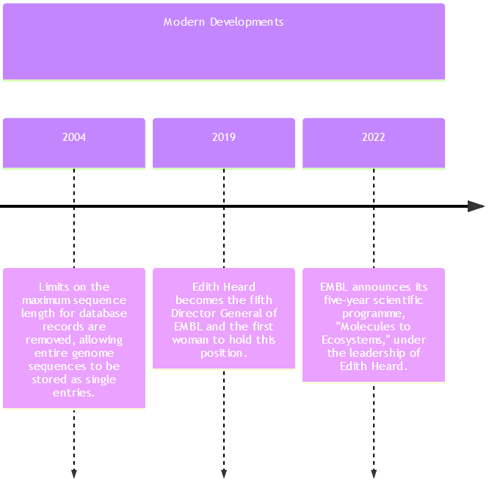
European Nucleotide Archive (ENA) 🌍
Sources
https://www.embl.org/about/history/
Notes:
timeline
title Evolution of EMBL
section Founding and Early Years
1974 : EMBL is founded when 10 countries sign an intergovernmental treaty to establish a European life sciences laboratory.
1975 : EMBL's French site is officially founded, focusing on structural biology research, services, and instrumentation development.
1977 : EMBL conducts its first officially recorded practical course, marking the beginning of its commitment to training scientists.
1978 : The main laboratory in Heidelberg, Germany, is officially inaugurated, serving as the headquarters for EMBL's research activities.
section Database and Technology Advancements
1980 : The EMBL Data Library is established, laying the foundation for the European Nucleotide Archive.
1982 : The first release of the EMBL Nucleotide Sequence Database is made, containing around 500,000 base pairs.
1987 : The EMBL File Server is introduced, serving database records over early networks like BITNET, EARN, and the Internet.
section Relocation and Expansions
1993 : EMBL's Nucleotide Sequence Database is relocated to the European Bioinformatics Institute (EBI) from Heidelberg.
section Modern Developments
2004 : Limits on the maximum sequence length for database records are removed, allowing entire genome sequences to be stored as single entries.
2019 : Edith Heard becomes the fifth Director General of EMBL and the first woman to hold this position.
2022 : EMBL announces its five-year scientific programme, "Molecules to Ecosystems," under the leadership of Edith Heard.

Slide 10
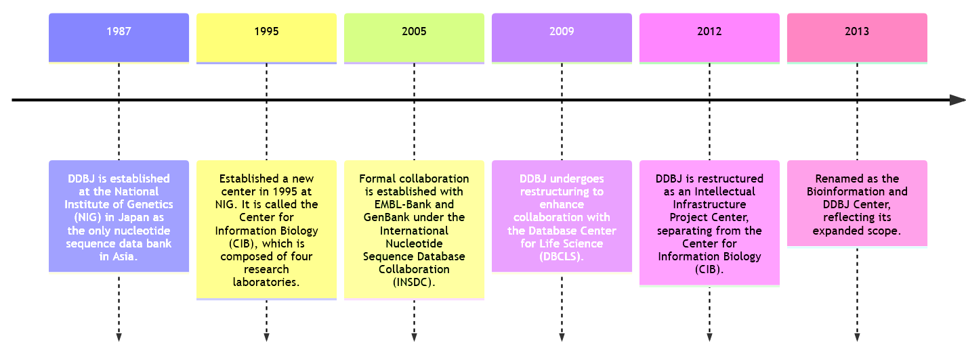
DNA Data Bank of Japan (DDBJ) 🌏
Notes:
timeline
title Evolution of the DNA Data Bank of Japan (DDBJ)
1987 : DDBJ is established at the National Institute of Genetics (NIG) in Japan as the only nucleotide sequence data bank in Asia.
1995 : Established a new center in 1995 at NIG. It is called the Center for Information Biology (CIB), which is composed of four research laboratories.
2005 : Formal collaboration is established with EMBL-Bank and GenBank under the International Nucleotide Sequence Database Collaboration (INSDC).
2009 : DDBJ undergoes restructuring to enhance collaboration with the Database Center for Life Science (DBCLS).
2012 : DDBJ is restructured as an Intellectual Infrastructure Project Center, separating from the Center for Information Biology (CIB).
2013 : Renamed as the Bioinformation and DDBJ Center, reflecting its expanded scope.

Slide 11
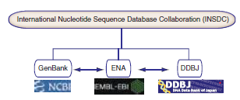
International Nucleotide Sequence Database Collaboration (INSDC)
Members synchronize data
Fundamentally stores:
Assembled sequences (GenBank/EMBL-Bank/Trad)
Studies (BioProject/Project/BioProject)
Samples (BioSample/Sample/BioSample)
Raw reads (SRA/ENA/SRA)

Slide 12
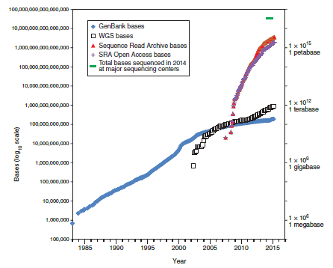
Exponential growth
Exponential growth since founding(s)
Even more rapid growth with NGS

Slide 13
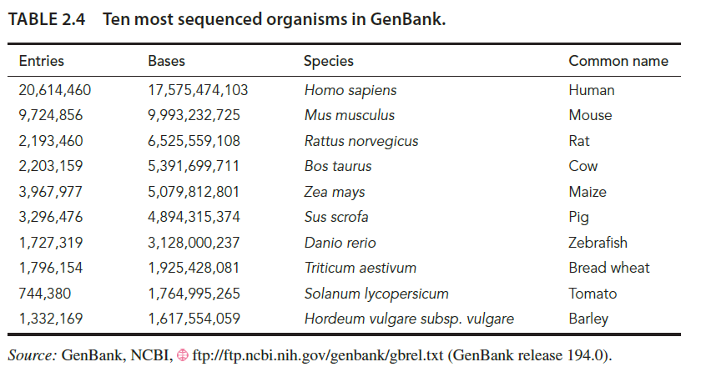
Most sequenced genomes
Mostly eukaryotes
Note this is by number of nucleotides
Note this table was from 2015
Notes:
Took this table from the book and so the most number of sequenced genomes will be different.

Slide 14

What was the most sequenced genome in 2020 and beyond?
Notes:
Just a fun question
SARS-CoV-2 13.6M records shown on NCBI (likely some redundancy however) (Fall 2024)
Flu 1.1M segment records on NCBI (Spring 2024)
probably a million of HIV, but unsure because they are in private databases (unverified; source: speculation with some colleagues, Fall 2022)
665k Salmonella (Fall 2024)

Slide 15
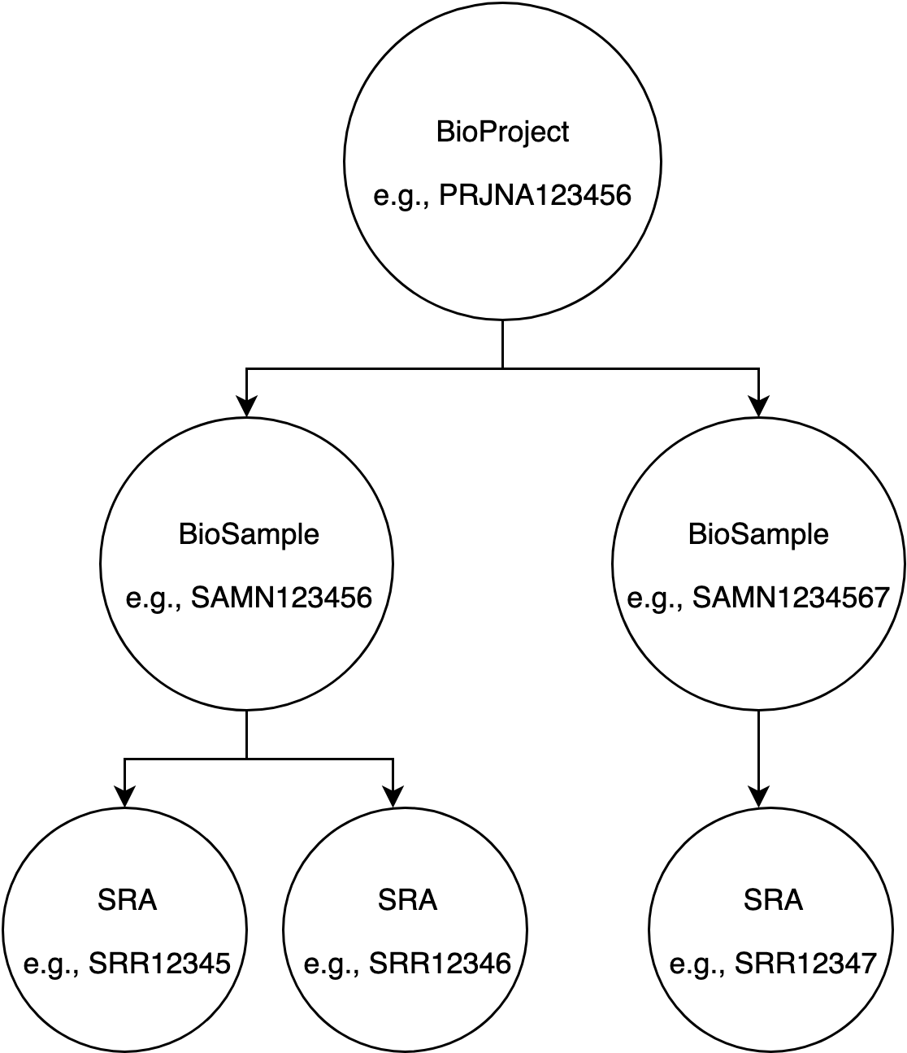
NCBI databases
Bioproject - contains things
BioSample - sample information
SRA
raw reads
sequencing information
Nucleotide
(refseq)
nucleotide

Slide 16

Bioprojects
Notable bioprojects
human genome(s)
1000 genomes project
ENCODE
pulsenet
genometrakr
metagenomics
Notes:
The purpose of the project is to support the discovery and understanding of genetic variants that influence human disease. Specifically defined goals are (a) the discovery of single nucleotide variants at frequencies of 1% or higher in diverse populations, (b) even more comprehensive discovery (variants down to frequencies of 0.1 - 0.5%) in functional gene regions, and (c) discovery of structural variants, such as copy number variants, other insertions and deletions, and inversions, including sequence-level understanding of breakpoints. The volume of data generated by 1000genomes project is unprecedented. The data is accessible from two mirrored ftp sites at EBI and NCBI.
The aim of the ENCODE project is to identify all functional elements in the human genome sequence through the generation of a diverse collection of high-throughput datasets and mapping these datasets onto the human genome sequence. The ENCODE Project involves close interactions between computational and experimental scientists to analyze the data and to evaluate different methods for annotating functional elements of the human genome.
The human microbiome refers to the community of microorganism that live in or on the human body. The Human Microbiome Project (HMP) is an NIH Roadmap project that was initiated to generate resources to enable comprehensive characterization of the human microbiota and analysis of its role in human health and disease. The HMP centers will sequence the genomes of a set of microoganisms that have been previously isolated from the human body. In addition, samples from the digestive tract, mouth, skin, nose, and female urogenital tract of human volunteers will be sequenced for 16S ribosomal RNA analysis and considered for metagenomic analysis.
PulseNet is the molecular surveillance system for multiple bacterial organisms, from CDC
GenomeTrakr is the molecular surveillance system for multiple bacterial organisms, from FDA

Slide 17
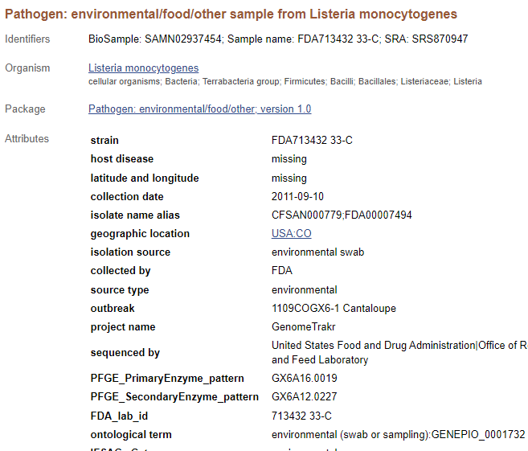
BioSample
BioSample Accession
colloquial: “SAM-N” numbers
Sample information
Strain name
Date of collection
Location
Collected by
Outbreak code
etc

Slide 18
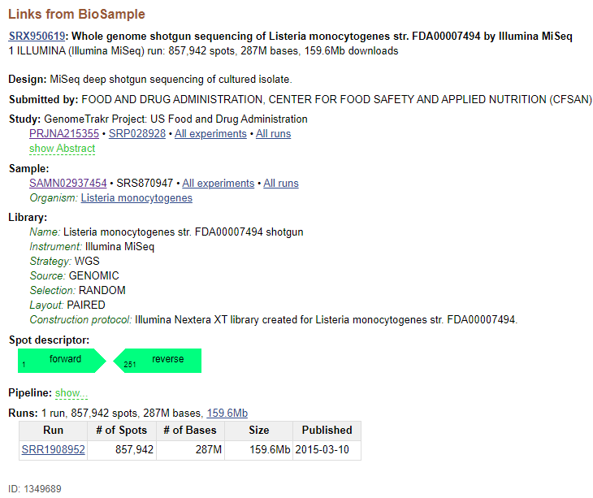
SRA
A few different accession types
Study
Study type
Description
…
Study accession
Experiment
Protocol
Library ID
…
Experiment accession
Run
SRA Run ID
Data files
one-to-many
one-to-many

Slide 19
SRA Run
Data about the sequencing
Paired end?
Number of spots (reads)
Number of bases
Size
Publish date

Slide 20
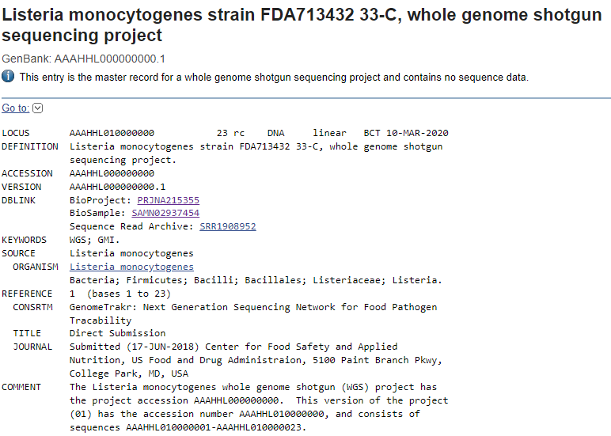
Nucleotide
DNA sequence
Assembly information
Gene annotations
Author information
So much information here not mentioned!
Notes:
Each gene annotation:
coordinates
gene name if known
protein product
if CDS or RNA or what

Slide 21
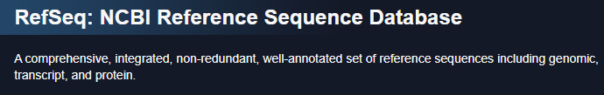

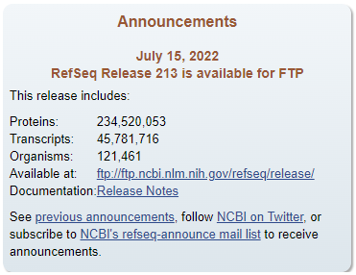
RefSeq
A curated copy of Nucleotide
Why?
Anybody can submit to NCBI
NCBI cannot QC its data
Therefore, a copy is the only QC
Fixes
Genome annotation
Gene characterization
and more!
Notes:
RefSeq is also a copy of RNA, protein, and transcript databases
anybody could submit to NCBI including Oscar the Grouch

Slide 22
Genomic epidemiology
ERIC L. STEVENS, HEATHER A. CARLETON, JENNIFER BEAL, et al ; Use of Whole Genome Sequencing by the Federal Interagency Collaboration for Genomics for Food and Feed Safety in the United States. J Food Prot 1 May 2022; 85 (5): 755–772. doi: https://doi.org/10.4315/JFP-21-437

Slide 23
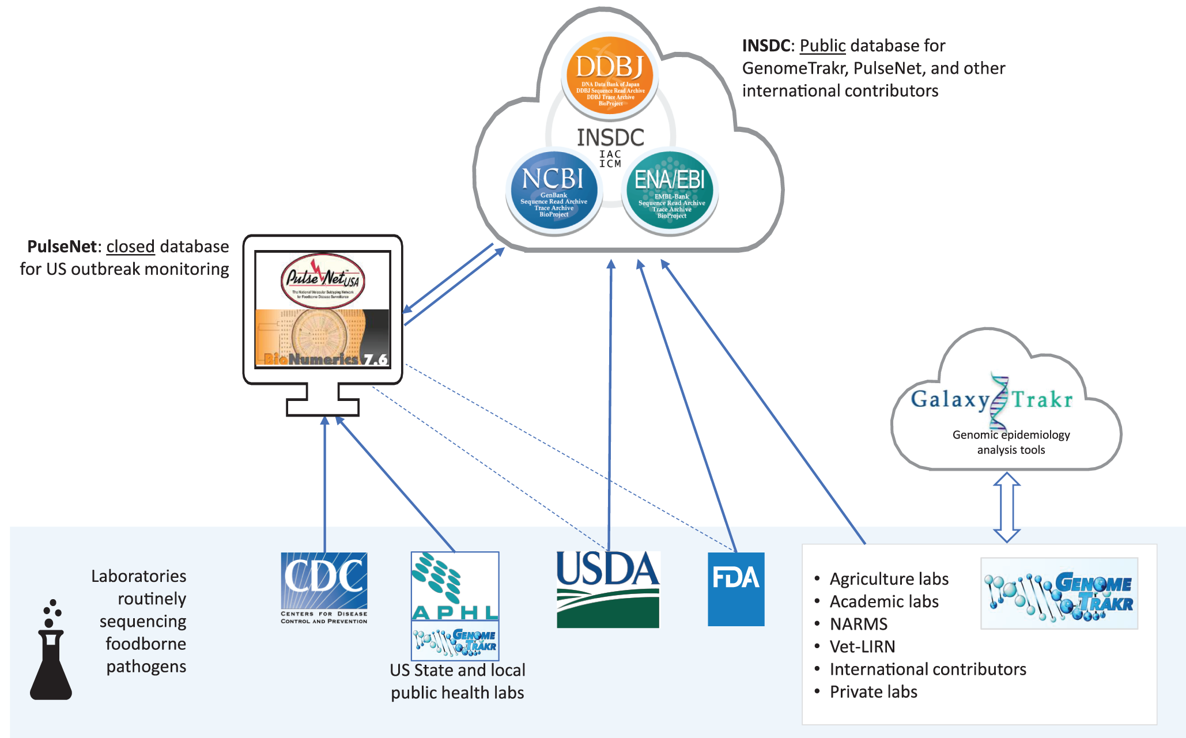
Gen-FS: genomics of food safety
Notes:
Collaboration b/n
CDC
FDA
NCBI
FSIS/USDA
APHIS/USDA

Slide 24
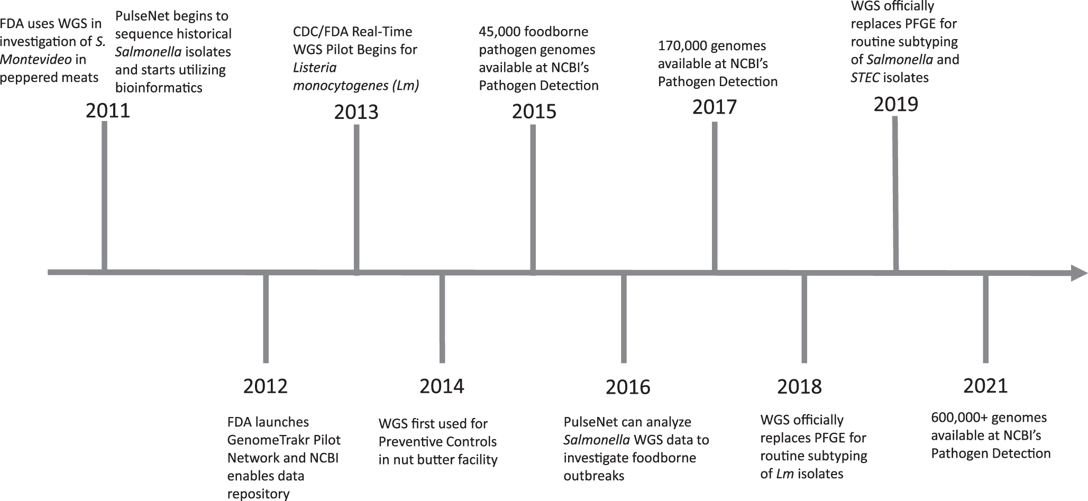
Gen-FS: genomics of food safety
… and all these data go into NCBI Pathogens

Slide 25
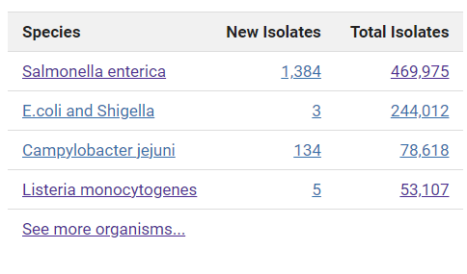
NCBI Pathogens
A way of housing all bacteria of a species for comparison
it pulls from databases (it is a derivative and in some cases suppresses)
How it helps us in genomic epidemiology
https://ncbi.nlm.nih.gov/pathogens
Notes:
NCBI Pathogens pulls from databases: it is a derivative and in some cases suppresses

Slide 26
How do we actually access data?

Slide 27
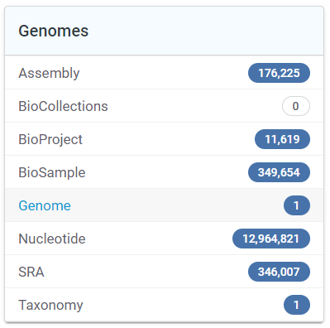



I want to look at all the genes of E. coli

Slide 28
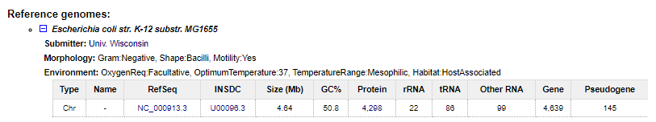
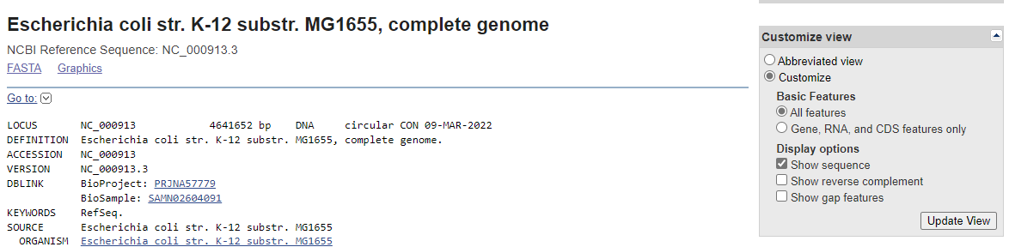
I want to look at all the genes of E. coli

Slide 29


Notes:
The database record could be huge

Slide 30
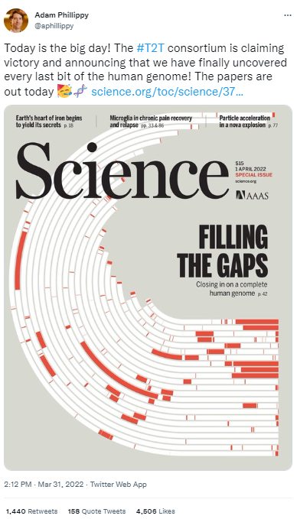
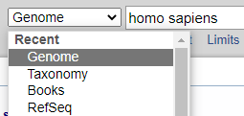
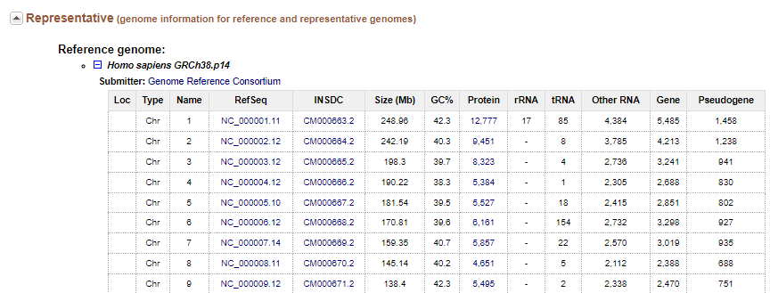
I want to download the human genome

Slide 31
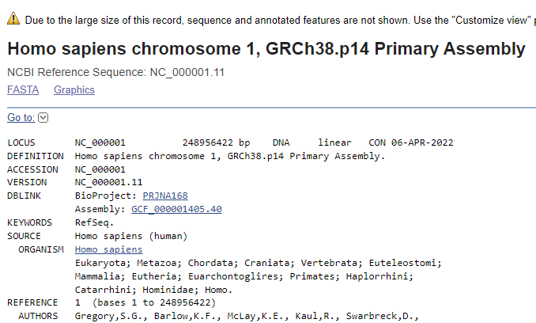
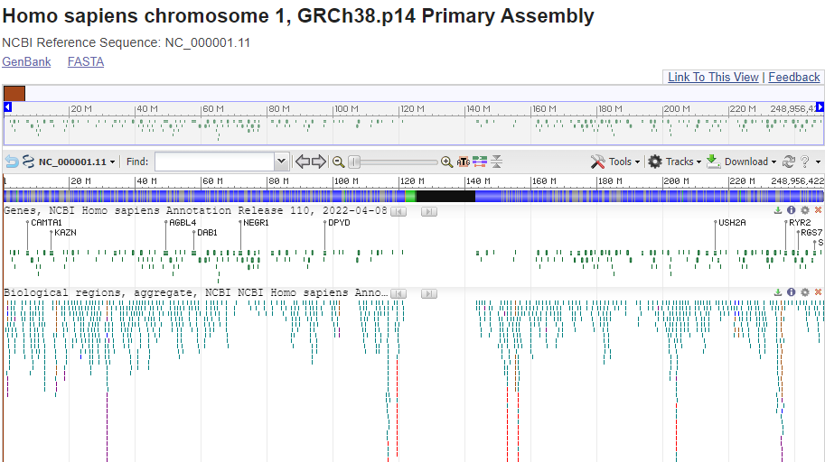
I want to visualize the human genome

Slide 32
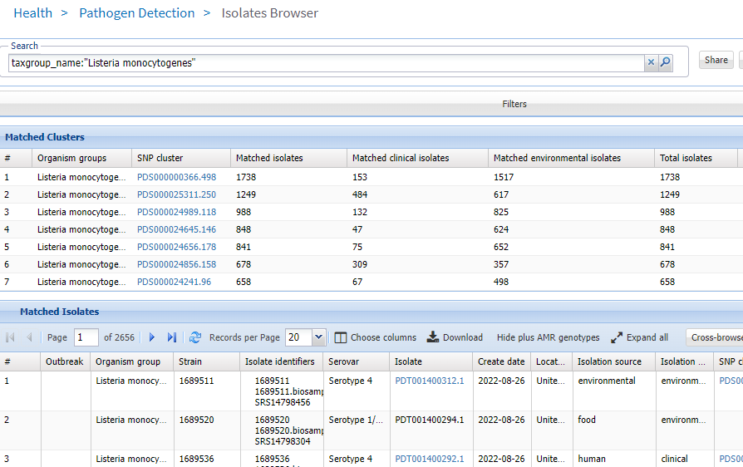
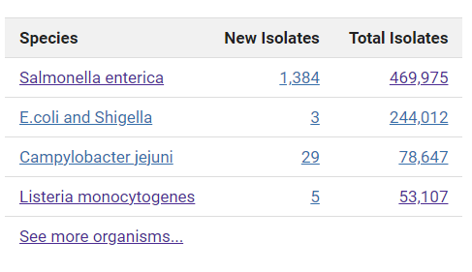
Let’s look at a Listeria outbreak cluster
Click “choose columns”, then bring “outbreak” over to visible columns

Slide 33
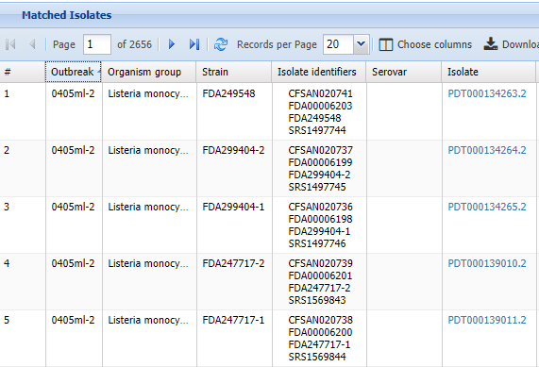
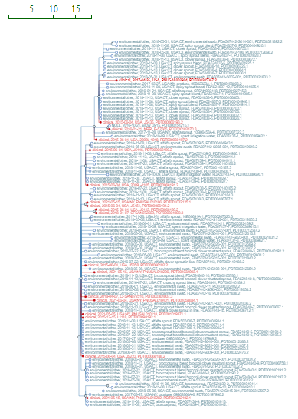
Let’s look at a Listeria outbreak cluster
Click to sort
Click on PDS000000308.30 which seems to be associated with alfalfa sprouts with an outbreak code 0808MAGX6-1mlc
Notes:
Can see a really nice tree showing the whole SNP cluster which may or may not be associated with an actual outbreak.
This is a phylogenetic cluster where I marked all clinical isolates red and left other isolates black.

Slide 34
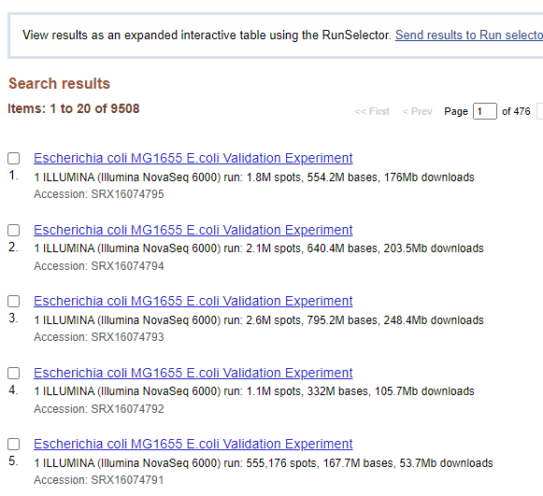
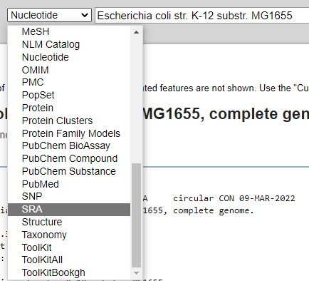
How did they sequence genome X?

Slide 35
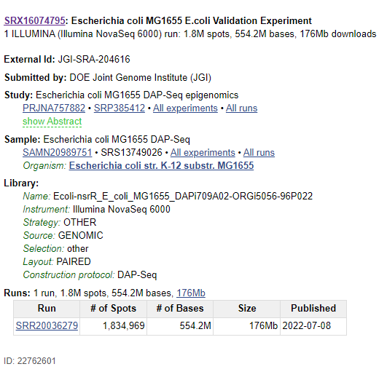
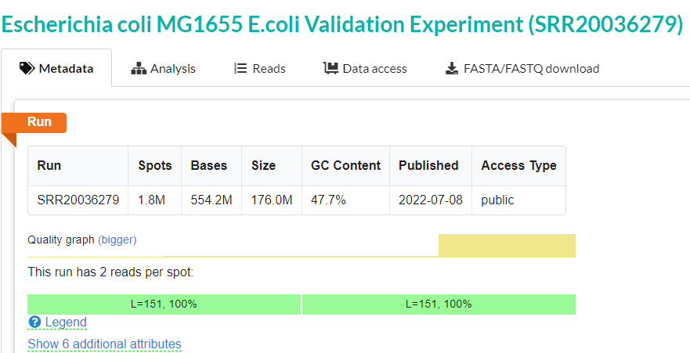
How did they sequence genome X?

Slide 36
There are so many other databases out there

Slide 37
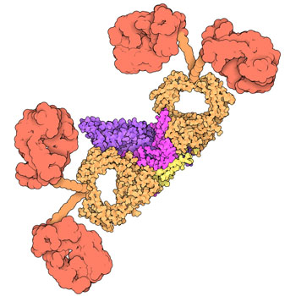
Proteins
why? function
Want to compare genes
Try to predict 3d structure of gene product
NCBI proteins
Uniprot
Swiss-prot
Protein databank (PDB)
3d structures of proteins

Slide 38

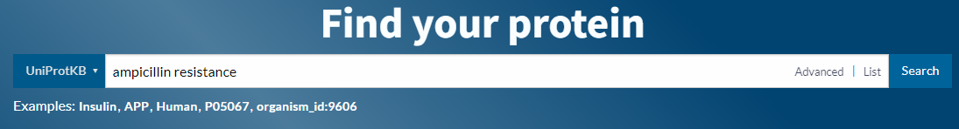
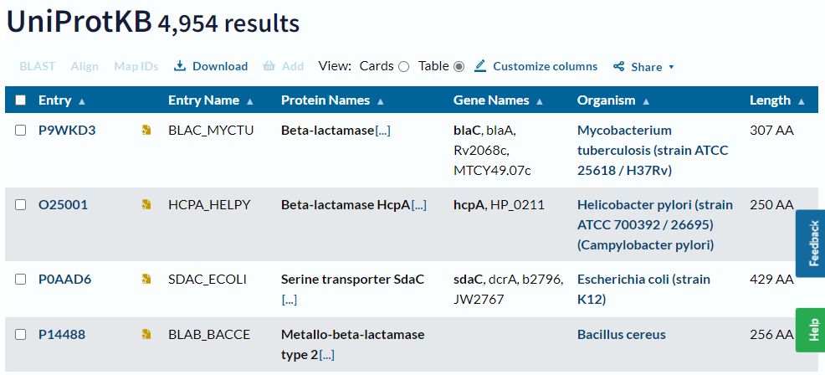
UniProt

Slide 39
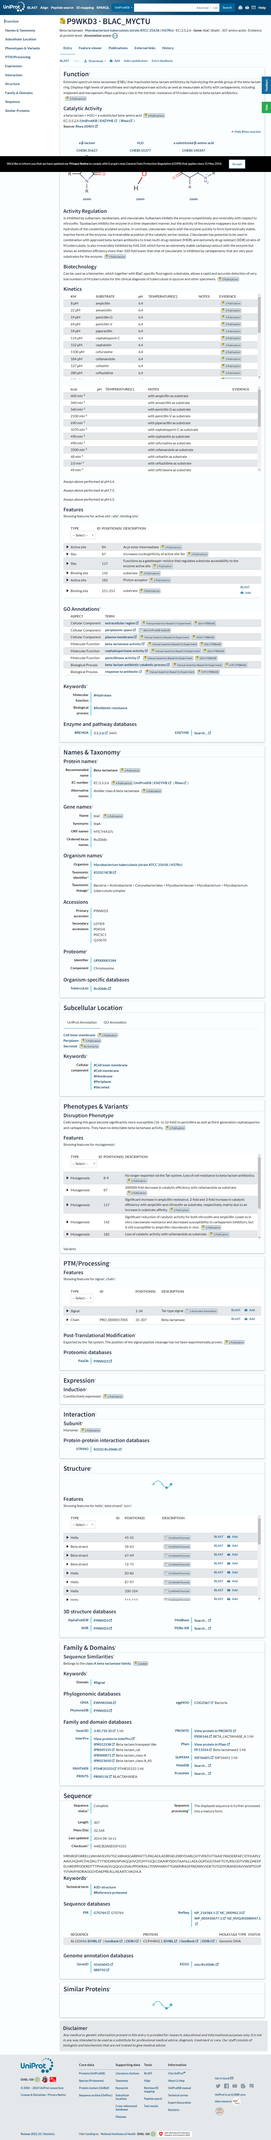

Slide 40
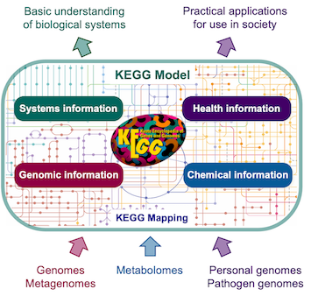
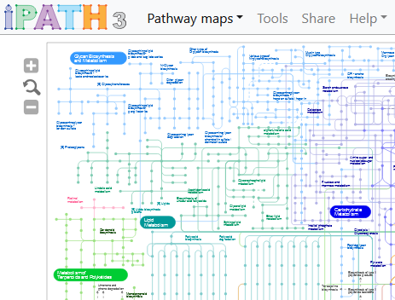
Pathway databases
KEGG
iPath
Notes:
KEGG: Kyoto Encyclopedia of Genes and Genomes - Kanehisa Laboratories
iPath – open source, from Germany

Slide 41
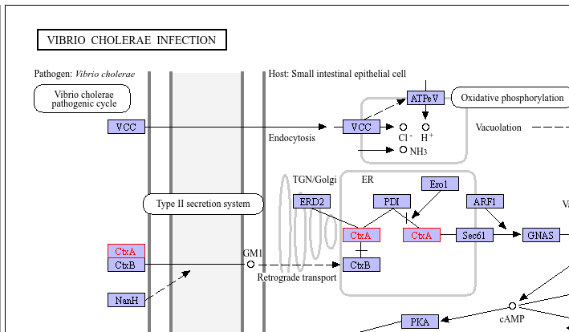
For example, CtxA in Vibrio cholerae
Notes:
Searching for the cholera toxin on KEGG provides this pathway map

Slide 42
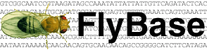






Genome databases
Flybase (fruit fly)
SGD (yeast)
WormBase (Nematodes)
GISAID (SARS-CoV-2 and influenza)
Generalized genome databases
PATRIC
UCSC
MicroScope/MaGe
EuPathDB (UGA)

Slide 43
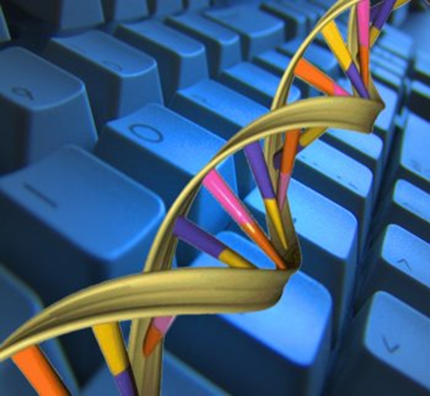
Questions?
Talking about our homework next
Notes:
We’ll talk about office hours and homework next

Slide 44
Office hours

Slide 45
Homework
Due Wednesday
Open book, open Internet, open friends
I reserve the right to have a slightly different version of the homework in iCollege, but here is a preview.

Slide 46
Homework: an NCBI treasure hunt
Q1
Q2: miscellaneous questions
Look up accession NM_005368.3 on NCBI
Which database within NCBI did this accession lead you to?
Nucleotide, SRA, Protein, BioSample, or other? If other, please identify the database
What species does it belong to?
Click on a button to visualize it and attach a screenshot of the whole visualization labeled $USER-NM_005368.3.png
You have a favorite gene. Which database on NCBI do you search?
What is the difference between RefSeq and Nucleotide? Answer in 1-3 sentences.
Which three organizations are part of the INSDC collaboration?

Slide 47
Homework: an NCBI treasure hunt
Q3
Q4
Find a sample PNUSAL000100 on NCBI
Who uploaded this sample? Give a name and an institution.
What database did you search?
When was this isolate collected?
What is the species and serovar of this sample?
Find the same sample PNUSAL000100 in the Assembly database, a database we have not discussed yet
What is the assembly accession? It starts with “GCA_”
How many contigs does it have?
How big is this genome? It may be listed under “total sequence length.”

Slide 48
Homework: specialized databases
Q5
Answer some quick questions about the following databases
How many SARS-CoV-2 genomes are in GISAID (gisaid.org)?
How many WormBase core genomes are there (wormbase.org)?
List one paper you would use to cite the UCSC genome browser.

Slide 49
Questions?

